Slide 1
Book Recommendation System

Slide 2
Sprint 1
Project Description
Problem Statement
Implementation of the Project

Slide 3
A recommendation system helps an organization to create loyal customers and build trust by them desired products and services for which they came on your site. The recommendation system today are so powerful that they can handle the new customer too who has visited the site for the first time. They recommend the products which are currently trending or highly rated and they can also recommend the products which bring maximum profit to the company
Project Description

Slide 4
Problem Statement
Goal: Design book recommendation system by several methods and explore the strengths and weaknesses of each method.
Research Question:
How can we calculate the similarity between books based on their content? How can we apply it to a recommendation system?
How can we predict the rating that a user will give to books that they haven't read? How can we apply it to a recommendation system?
What are the strengths and weakness of each method? How to overcome the weakness?

Slide 5
Practical Implementation of Recommendation System
Loading the following 3 datasets
Books – first are about books which contain all the information related to books like an author, title, publication year, etc.
Users – The second file contains registered user’s information like user id, location.
ratings – Ratings contain information like which user has given how much rating to which book.

Slide 6
Importing Dataset
Import Dataset
In this project, we will use Goodreads dataset. This dataset consist of 5 files which are:
ratings.csv: contains user ratings for books they read
books_enriched.csv: contains metadata for each book (book ID, title, authors, year published, etc)
to-read.csv: contains books marked "to read" by users
book_tag.csv: contains tags/shelves/genres assigned by users to books
tag.csv: contains the tag names corresponding to the tag ids in book_tag.csv

Slide 7
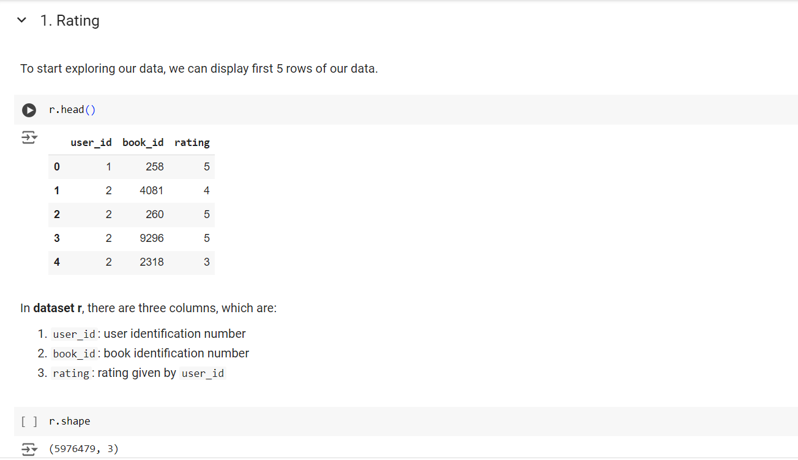
Data Understanding

Slide 8
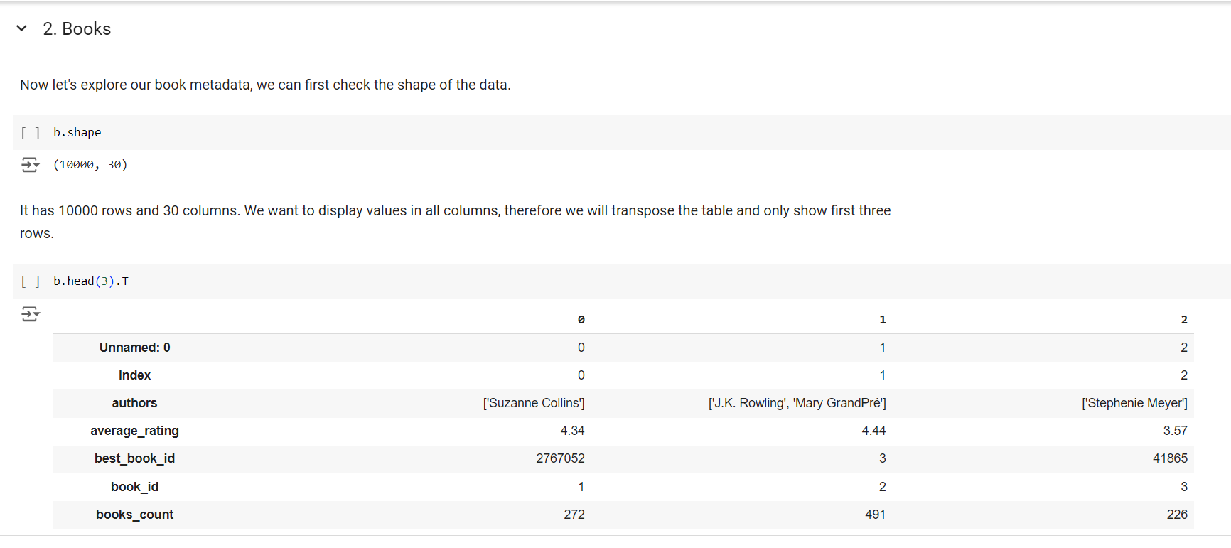

Slide 9
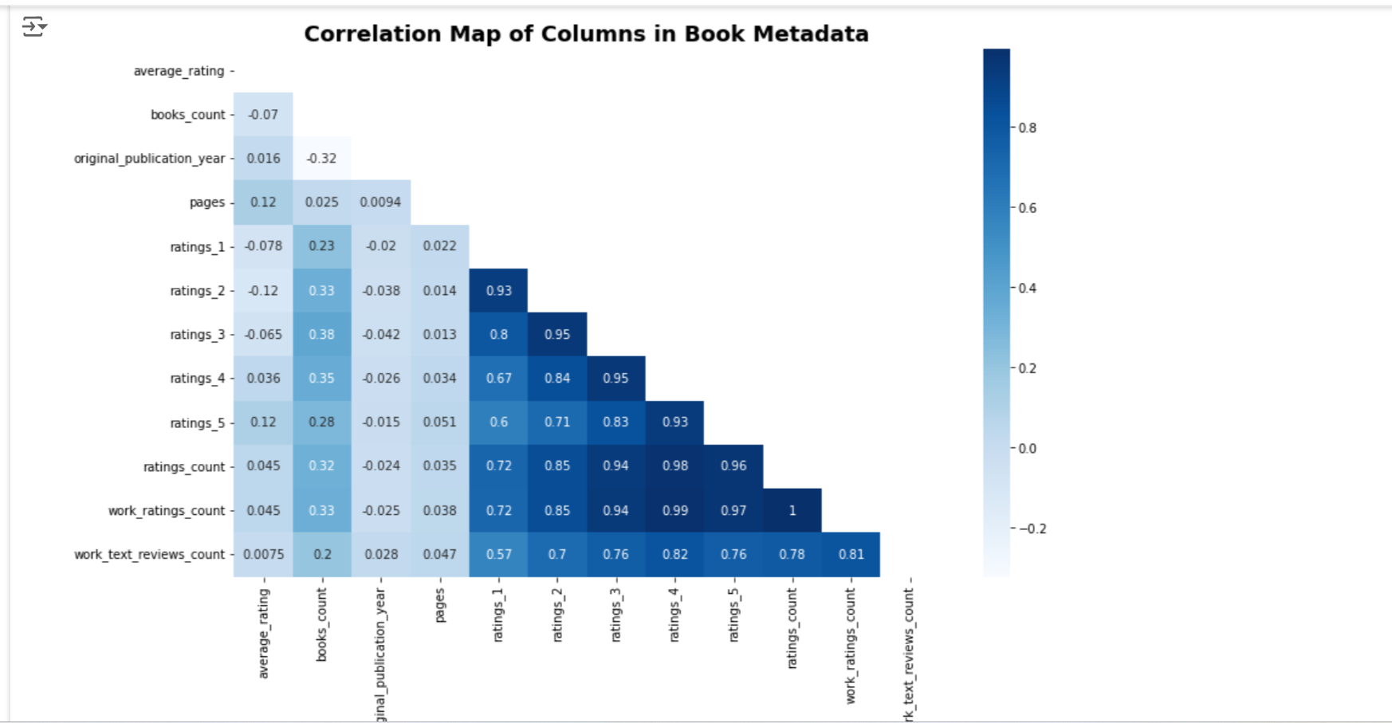
Correlation Matrix

Slide 10
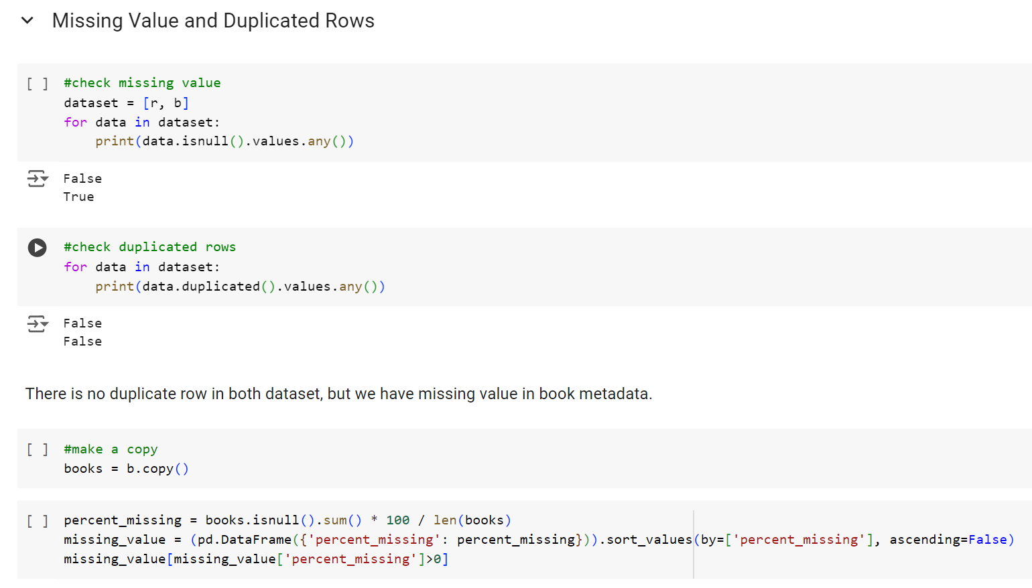
Data Preprocessing
In building machine learning models, we should check for missing values and duplicated rows in our data.
In this process we should also transform data into a format that is easier and more effective to process, so that our model will produce more accurate results.

Slide 11
Exploratory Data Analysis
In this part, I explore the data to get understanding about the dataset.
How is the rating for all books distributed?
How is the average rating per user distributed?
How many ratings does a book usually get?
How many ratings does a user usually give?
Does the ratings count affect average rating?
Which book has the highest rating and which book has the most ratings?
How is the relationship between the number of ratings and the average rating?
Who is the author with most books?
Who is the most popular author?
Who is the author that has good ratings book?
How is the relationship between the number of pages and the year the book was published?
What genre dominates the dataset?

